Slide 1
Kaxan
The Blockchain for Indigenous Communities
TEAM:
AGNES OLSHANSKY
DARIUS ZAMANI
KEILA OROPEZA
STEPHEN BODWELL
Boston Blockchain Hackathon
May 12, 2019
Notes:
Describe the pain point or problem that you’re alleviating.

Slide 2
PROBLEM
Firms use designs
done by indigenous communities
without transparency
Notes:
Describe the pain point or problem that you’re alleviating.

Slide 3
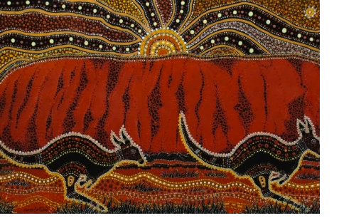
PROBLEM
$300MM
0
52%
Aborigines Art Industry
Transparency
Indigenous Unemployment
Indigenous disadvantage in Australia. (n.d.). Retrieved from https://australianstogether.org.au/discover/the-wound/indigenous-disadvantage-in-australia/
Soto, R. (n.d.). Aboriginal Art Market and Prices. Retrieved from http://aboriginalartonline.com/resources-market-php/
Painting of Uluru by Danny Eastwood | © Karlangu Aboriginal Art Centre
Notes:
Describe the pain point or problem that you’re alleviating
.
Aborigines Art industry = 100 million to 300 million AUS dollars
No transparency on native artisan beneficiaries of their work
Indigenous unemployment is 52% compared to Non-indigenous unemployment of 25%

Slide 4
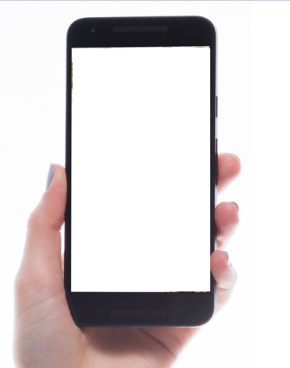


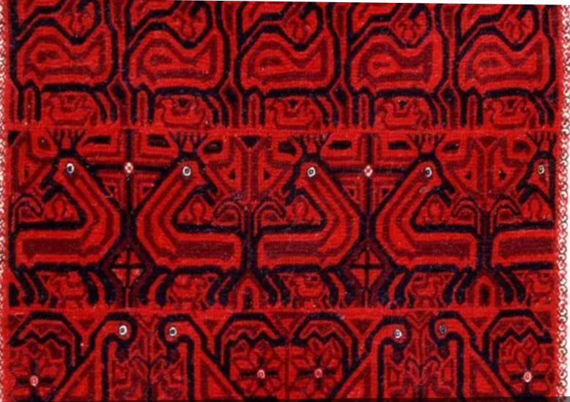
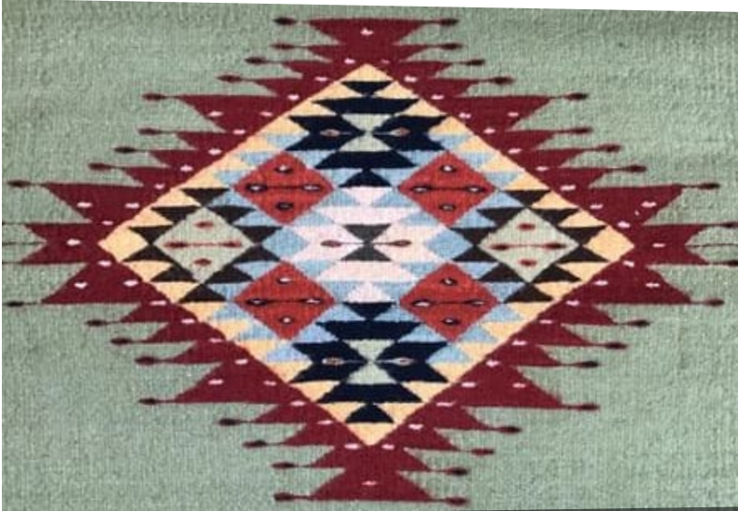
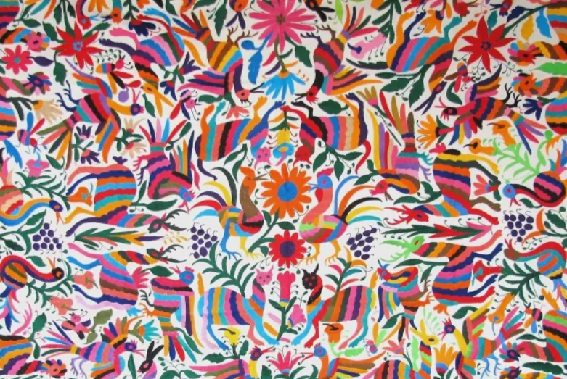
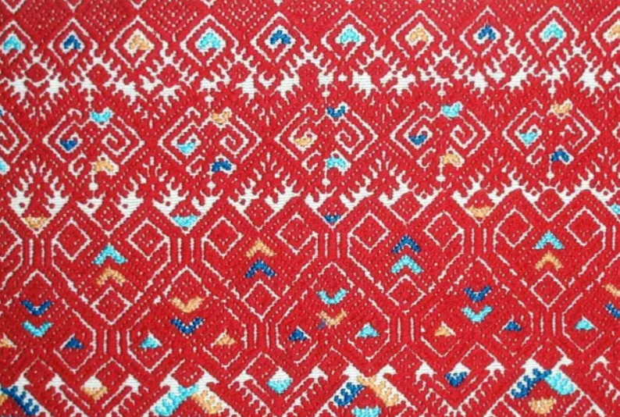
SOLUTION
KAXAN – The Blockchain for Indigenous Communities
Protected Designation of Origin
Help Sign Up Log In
IPFS
Country:
Colombia
Mexico
Peru
USA
Search design by community, product, etc.
Upload your images
Mazahua, Mexico MX
Zapoteco, Oaxaca MX
Community:
Inca
Maya
Mixe
Nahuatl
Navajo
Otomi
Otomi, Hidalgo MX
Totsil, Chiapas MX
Product:
Textile
Ceramic
More(300)
Notes:
Explain the value of the pain or problem you are alleviating….benefits of the solution, value add

Slide 5
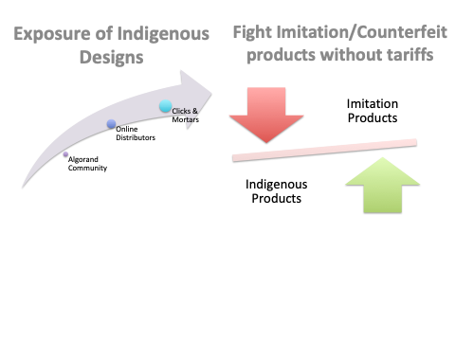
SOLUTION
Notes:
Explain the value of the pain or problem you are alleviating….benefits of the solution, value add

Slide 6
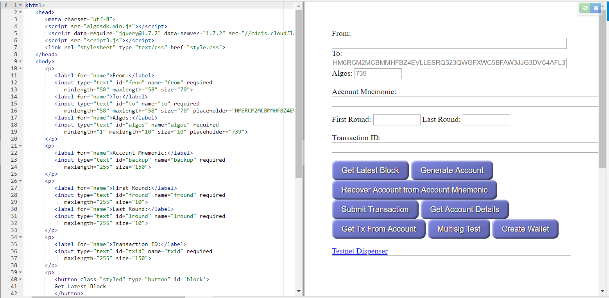
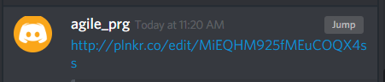
BUSINESS MODEL
Notes:
Who wants to buy what you are selling?
How will your business operate – identify revenue resources, customer base, etc.
What is your company's plan for making a profit. Identify the products or services your business will sell, the target market it has identified, and the expenses it anticipates.

Slide 7
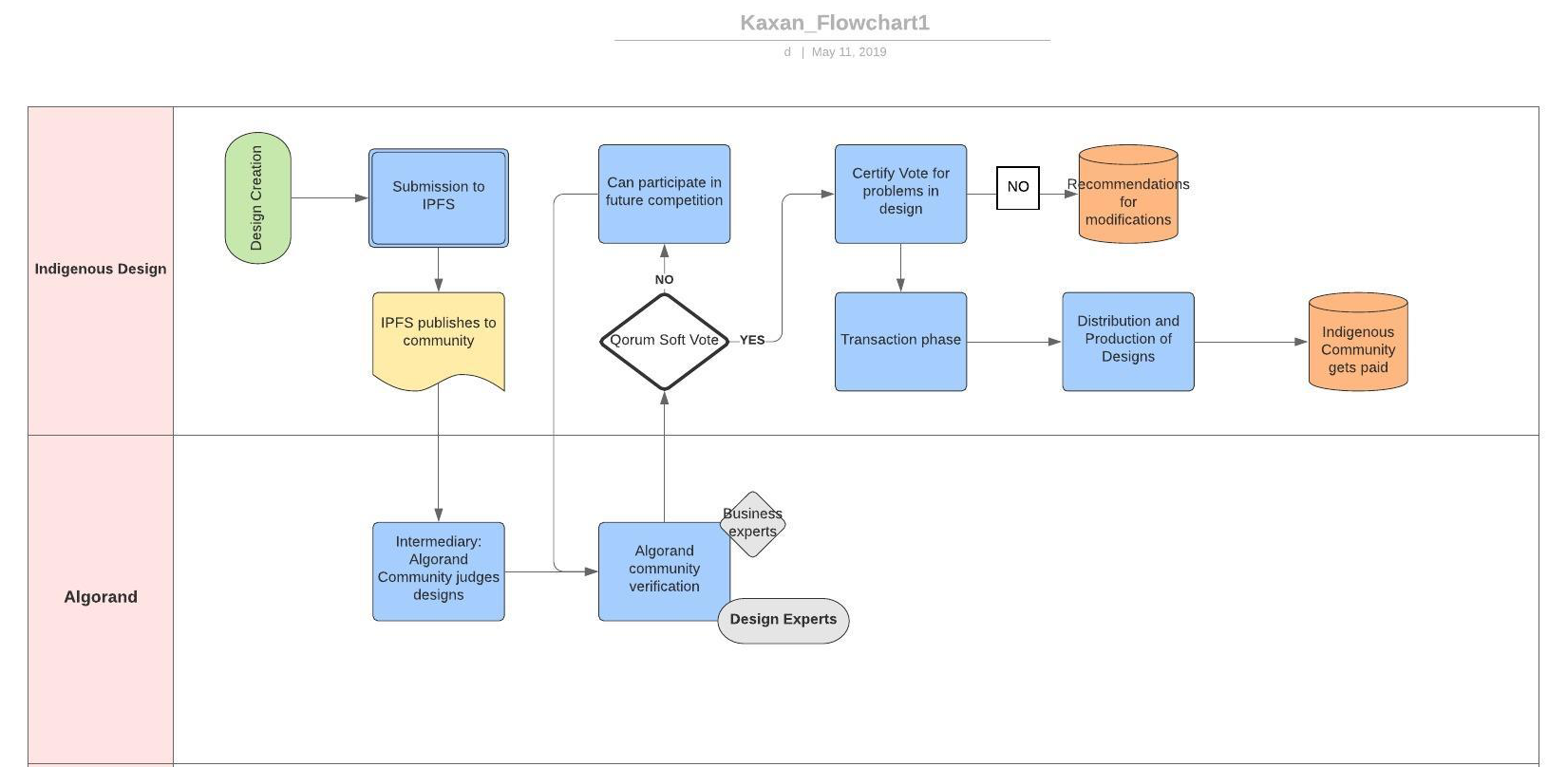
BUSINESS MODEL
Notes:
Who wants to buy what you are selling?
How will your business operate – identify revenue resources, customer base, etc.
What is your company's plan for making a profit. Identify the products or services your business will sell, the target market it has identified, and the expenses it anticipates.

Slide 8
BUSINESS MODEL
Algorand Community
Indigenous Community
Transactions
Distribution
Soft Vote
Certify Vote
Designers
Buyers
Designer 2
Designer 3
Designer 1
Winner moves forward
Notes:
Who wants to buy what you are selling?
How will your business operate – identify revenue resources, customer base, etc.
What is your company's plan for making a profit. Identify the products or services your business will sell, the target market it has identified, and the expenses it anticipates.

Slide 9
BUSINESS MODEL
US$ 526.5 B
3%
Transaction Fee
Global Market Size
Market Share
Revenue
https://www.prnewswire.com/news-releases/global-handicrafts-market-2018-2023-market-reached-a-value-of-us-526-5-billion-in-2017-and-is-expected-to-reach-984-8-billion-by-2023--300686507.html
Notes:
Who wants to buy what you are selling?
How will your business operate – identify revenue resources, customer base, etc.
What is your company's plan for making a profit. Identify the products or services your business will sell, the target market it has identified, and the expenses it anticipates.

Slide 10




GO-TO- MARKET PLAN
Offline & online marketing
Textile/Tourism Industry Events
Fashion/Tourism Blogs/Magazines
Search & Social Media Ads
Collaboration with NGO/Non Profits
Notes:
Explain how you would reach your customer without breaking the bank.

Slide 11
FUTURE DIRECTIONS
Web application as an intermediary to upload images and data in lieu of IPFS
Node running on smartphones to run service on mobile platforms (Currently in progress*)
Currently using “Note Field” feature attached to transactions until smart contracts are implemented.
*www.textile.photos
Notes:
Explain how you would reach your customer without breaking the bank.

Slide 12
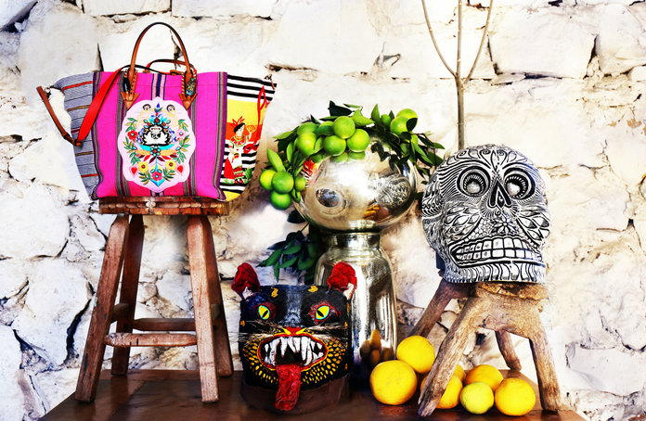
THANK YOU
Notes:
https://www.instyle.com/fashion/accessories/christian-louboutin-mexicaba-bag

